Slide 1

Acoustic Resonance Testing
www.SonicDiagnostic.com

Slide 2
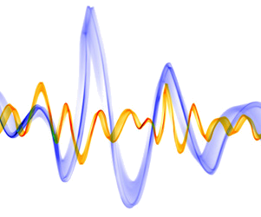
Introduction
Acoustic Resonance Testing is a non-destructive testing based on modal analysis (vibration analysis) of parts.
In this method, structural dynamic signatures of parts are measured.
The dynamic features consists of natural frequencies, damping coefficients, and mode shapes. These features are directly correlated with mechanical properties (Elastic Modulus).
A structural defect changes the mechanical properties and dynamic features of the part. For example, a crack reduces the resonant frequency and increases the damping ratio.
By analyzing and comparing the features of “Good” and “Defective” parts, we can detect defective parts.

Slide 3
Synonym Names
Acoustic Resonance Testing | Commercial name
Resonant Ultrasound Spectroscopy (RUS) | Standard ASTM-E2001
Experimental Modal Analysis | Academic name

Slide 4

Vibrational Modes
All objects vibrate. Each object has its own vibrational modes.
Each mode represents a standing wave or resonance at a natural frequency.
Vibrational modes of each object are unique as finger prints of the object.
These modes describe the intrinsic dynamic properties of the object.

Slide 5
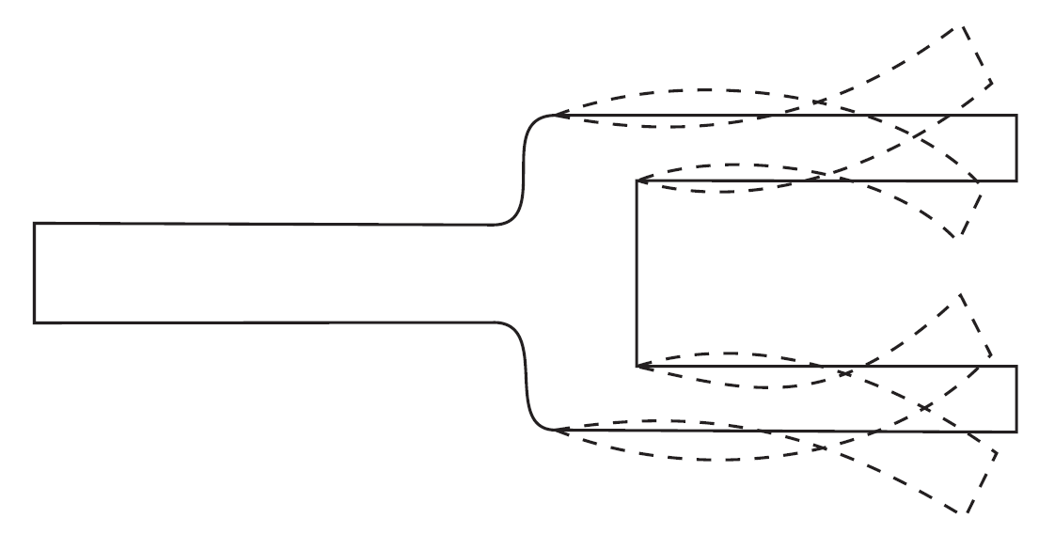
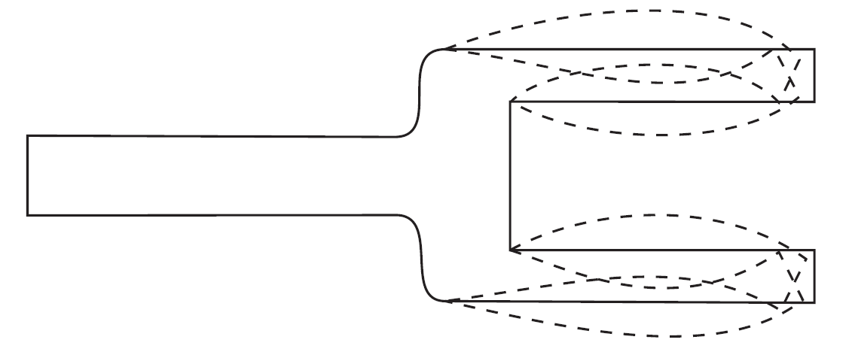
Excitation of Modes
When we impact an object or apply swept sine, we can identify its dynamic behavior or frequency response function.
In response to impact, all modes are excited and each mode vibrates at a specific frequency (eigenfrequency).
Each mode is a degree-of-freedom of vibration, which vibrates as a damped sinusoid at its natural frequency.
The overall vibration of an object is the superposition of all modal vibrations.
Mode 1
Mode 2

Slide 6
Frequency of Modes
An object has infinite number of modes or natural frequencies, which appear as peaks in frequency response.
The frequency of modes are a function of elastic properties and geometry (CAD drawing). These frequencies are independent of impact point and intensity, and sensor location.
Mode shapes (1-4) and frequency response of a rectangular plate.
The peaks represent natural frequencies.

Slide 7
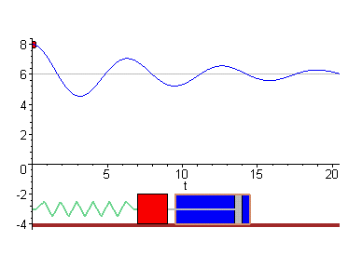
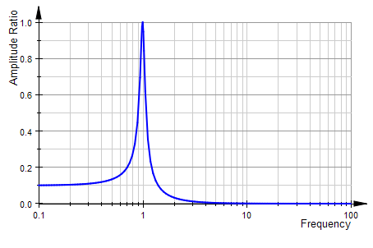

Simple Model of a Mode
We can model a mode (one degree-of-freedom) with the free vibration of a Mass-Spring-Damper.
The natural frequency of vibration (without damping) is
In structural vibration, k represents mechanical properties (Young modulus, Elastic properties), and m represents density and dimensions (geometry).
$$f=\frac{1}{2π}\sqrt{k/m}$$
Spring
k
Mass
m
Damping
c
Frequency Response

Slide 8
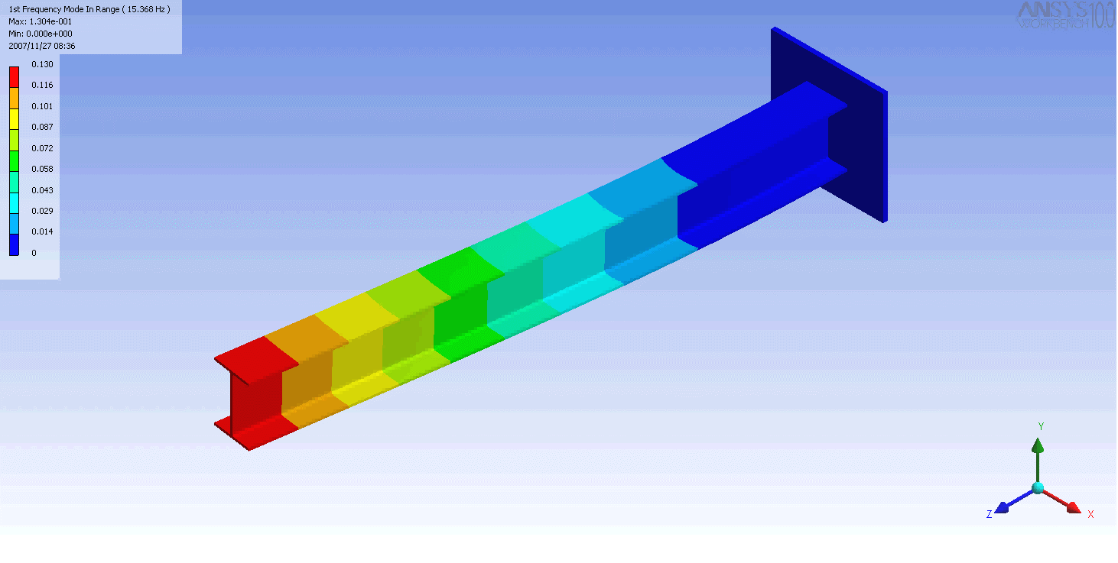
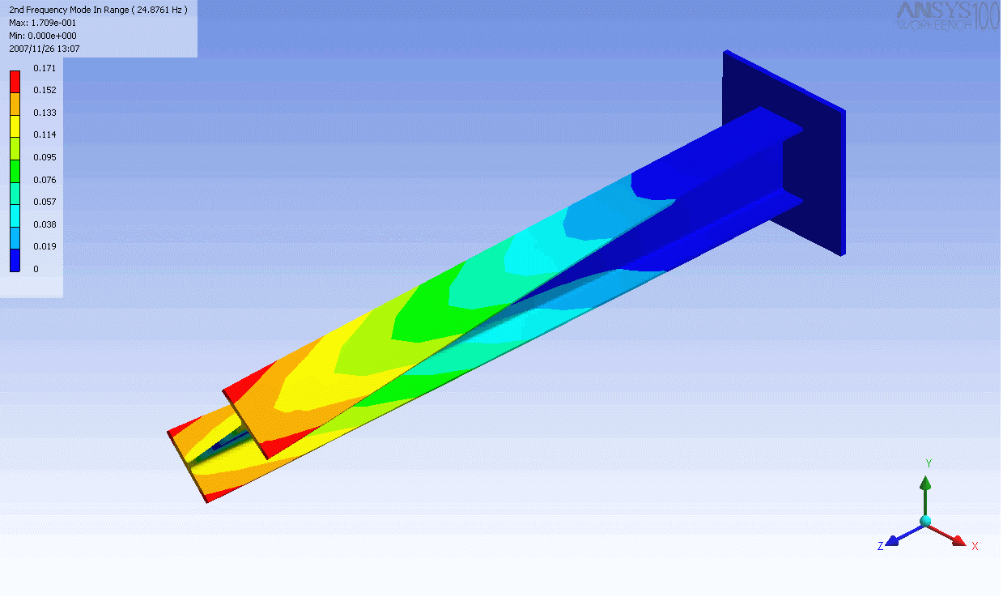
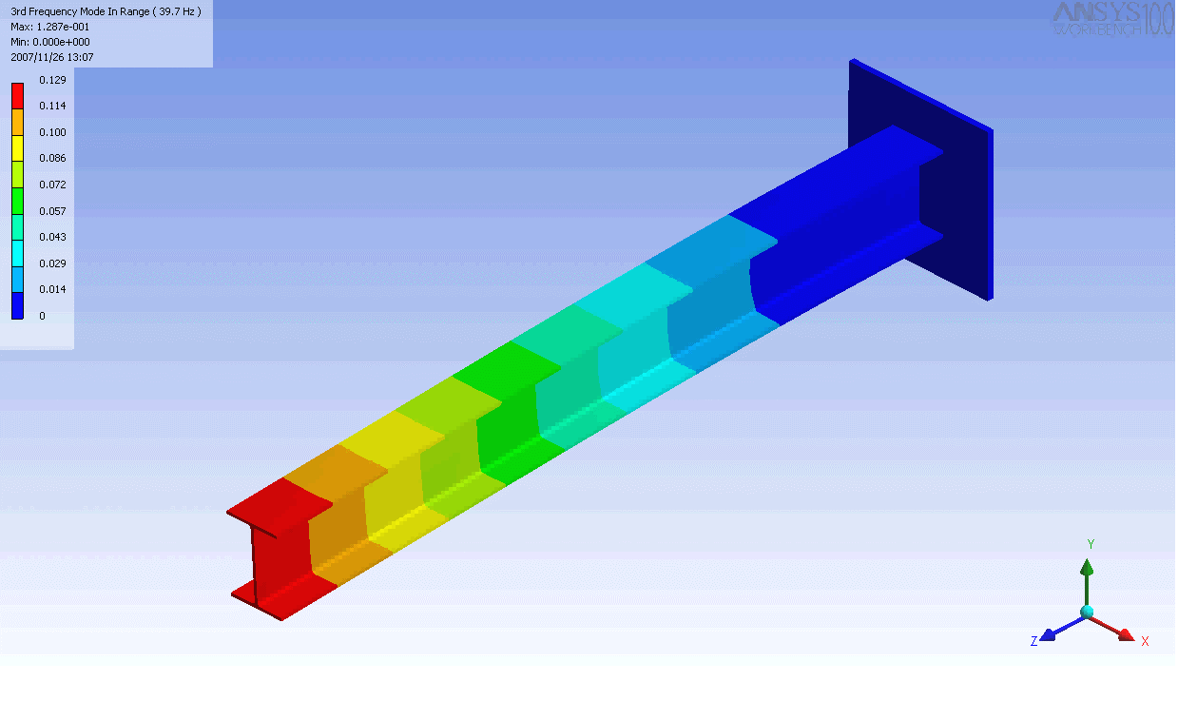
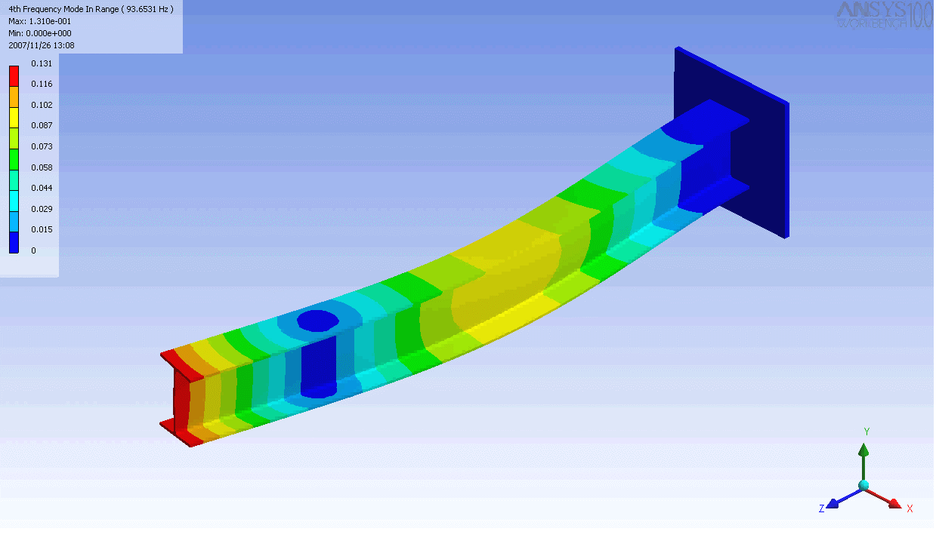
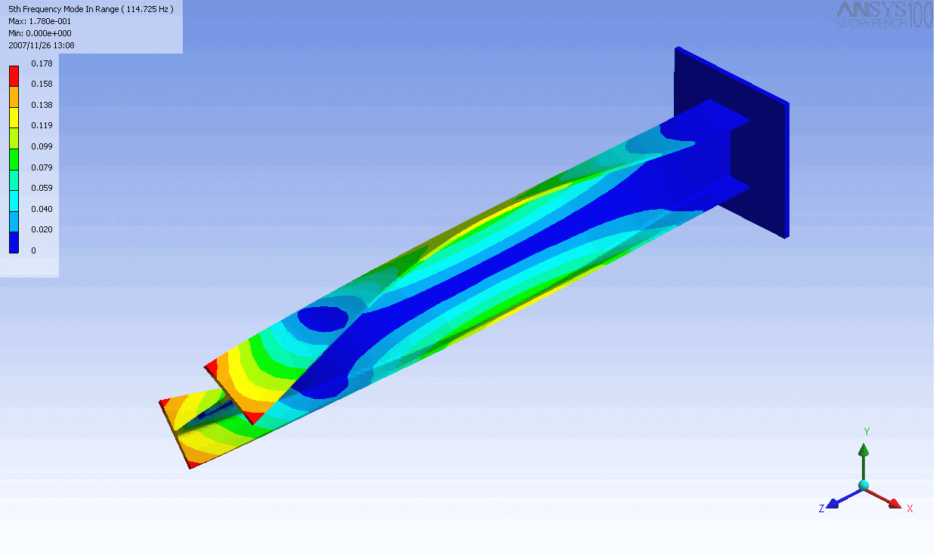
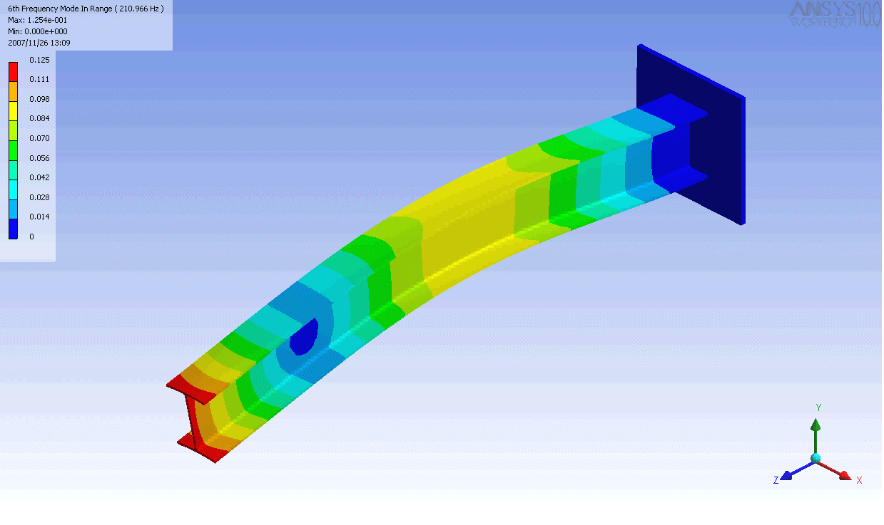
Finite Element Modeling of Modes
The modes can be calculated using FEM, which corroborate the experimental results.
Mode 1 (Bending)
Mode 2 (Torsional)
Mode 3 (Bending)
Mode 4 (Bending)
Mode 5 (Torsional)
Mode 6 (Bending)

Slide 9
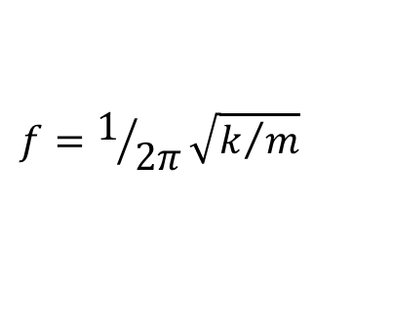
Correlation between Mechanical Properties and Natural Frequencies
A defect in a part reduces the stiffness k, and hence the natural frequency f is shifted (reduced) according to
The frequency shift has high correlation with fatigue or break strength. So the natural frequencies can represent the quality of a structure. This correlation is the basis of Acoustic Resonant Testing.
$$f=1/{2π}\sqrt{k/m}$$

Slide 10
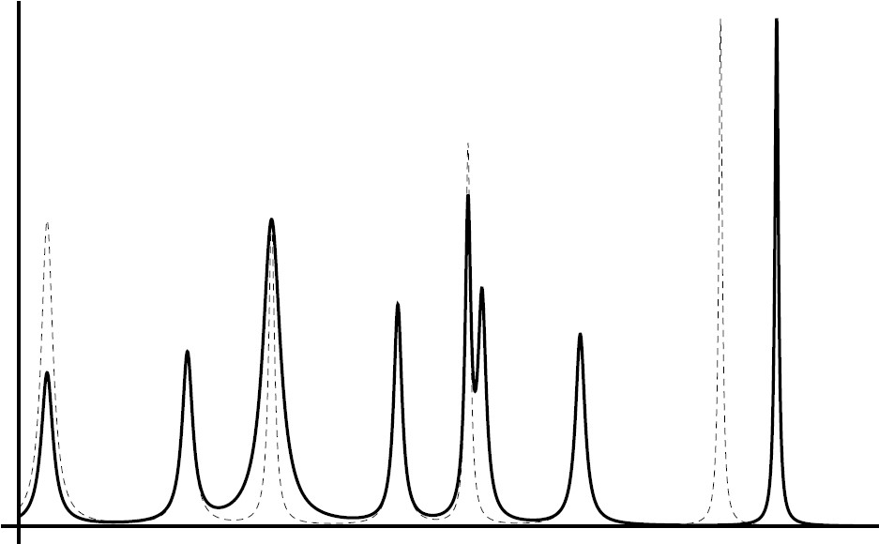
Changes in Frequency Response
Amplitude change
Damping change
Peak Split
Frequency Shift
Amplitude, dB
Good
Defective
Response changes due to different types of defects. Each peak corresponds to a vibration mode.

Slide 11
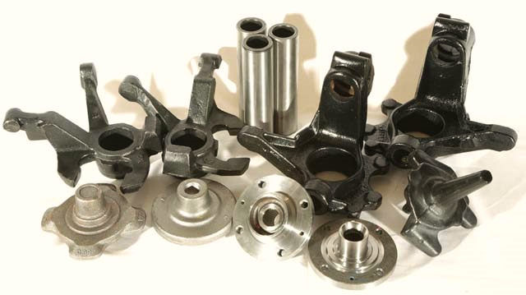
Applications
According to Standard ASTM-E2001, Resonance Testing can be used to detect defects in metallic and non-metallic parts. In a single measurements, the procedure can detect numerous defects including cracks, chips, cold shots, inclusions, voids, oxides, contaminants, missed processes or operations, and variations in dimension, hardness, nodularity, porosity, density, and heat treatment.
Detection of invisible defects is always a priority in industries.
In the past two decades many automobile part suppliers have turned to Acoustic Resonant Testing.

Slide 12
Applications
Industry | Defect Type | Product (example)
Ductile Cast Iron | Nodularity, Crack, Oxides, Cold Shuts, Porosity, Heat Treatment, Inclusions, Carbides, Hardness, Residual Stress | Knuckle arm, Break caliper, Trailing arm, Crossmember arm
Gray Cast Iron | Crack, Natural Frequency, Perlite | Camshaft, Brake disk,
Steel | Crack | Axle shaft, Drive shaft
Forgings | Crack, Bar Ends, Double Strikes, Laps, Water quench | Conrod, Knuckle arm
Aluminum Cast | Crack, Oxides, Elongation, Cold shuts, Shrink porosity, Blow holes | Pedals, Steering wheels
Ceramics and Glass | Crack | Industrial ceramics, tiles, bottles

Slide 13
Position of Acoustic Resonant Testing
NDT methods can be divided in two main groups:
Whole Body Test | Local Test
Whole part test Does not indicate flaw location, just reports “Pass” or “Fail” Relative Test: Needs “Reference Parts” for training, calibration, and data modeling Best for complex structures Examples: Eddy Current Hardness/Structure Test: Whole surface and sub-surface test | Indicates flaw location The part should be scanned for whole body test The result is subjective and depending on operator’s interpretation Examples: Visual Test (VT) Magnetic Particle Inspection (MP) Ultrasonic Test (UT) Eddy Current Crack Detection (ECT)
Acoustic Resonant: Whole volume test

Slide 14
Advantages and Disadvantages of Acoustic Resonant Testing
Advantages | Disadvantages
High correlation of results with mechanical properties Best for high volume 100% quality control Fast, accurate, and repeatable measurements Whole part test for internal and external flaws A single test detects different flaws Easily automated No part preparation required, no consumables expenses | Relative or Comparative test: Requires “Reference Parts” for any part setup Requires advanced mathematical modeling software to compensate production variations Does not indicate flaw location, just rejects the defective parts. However, other methods can then be used to locate and assess the flaw (e.g.: MP, UT, VT, Metallugraphy)

Slide 15
Compare with Ultrasonic Test (UT)
Advantages of UT | Disadvantages of UT
Very sensitive to cracks Immediate results Portable High penetration capability | Subjective results: Need for trained operators for manual inspections Complex or small parts are difficult to test Couplant and surface condition required Special probes required for different applications

Slide 16
Compare with Magnetic Particle (MP)
Advantages of MP | Disadvantages of MP
Detection of surface and subsurface cracks | Operator’s eye fatigue in dark room under UV light. On average, 20% of flaws are not detected due to lack of concertation. Ferromagnetic materials only Time consuming test Surface preparation required Messy Demagnetization required after test

Slide 17
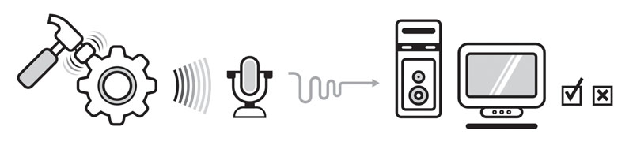
Test and Analysis Steps
Mechanical excitation of part: Using inertial impact hammer or swept sine vibration
Record the response: Using microphone, accelerometer, or piezo sensor
Calculate modal parameters: Natural frequencies and dampings, splits, nonlinear responses
Statistical data modeling and decision making: Model and compensate variations of production, temperature, and mass; Classify defects, Report “Pass” or “Fail”
Excite the part
Record the response
Extract modal parameters
Data modeling & Decision making

Slide 18
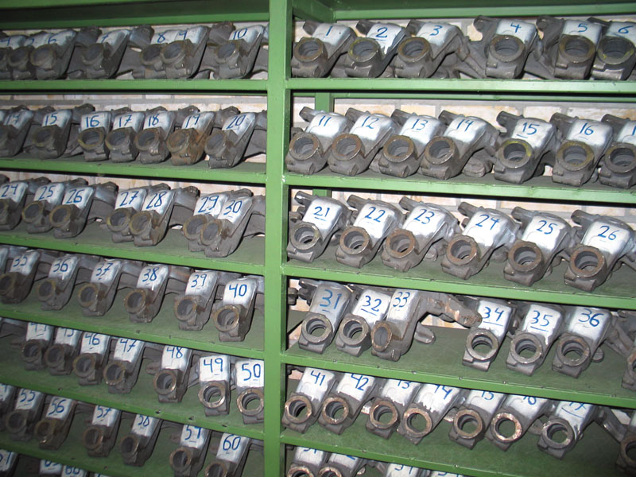
Reference Parts
Reference Parts are known “Good” or “Bad” parts which are used to train the system.
The accuracy of the system depends on careful preparation and analysis of the Reference Parts.
The Reference parts should be validated by other methods, e.g.: MP, UT, VT, Metallugraphy
The Reference Parts should cover the variations of production, e.g.: 200 parts from different lots during 2 months of production

Slide 19
Statistical Modeling
Data and Pattern Modeling: Multivariate formulation between defects and changes in modal parameters in order to sort “Good” and “Bad” parts
Compensation: Cancel the effects of unwanted variations in production, e.g.: mass, dimensions, material, and temperature
Statistical Tools: Outlier cancellation, Check ranges of frequencies and dampings, Regression, Classification, PCA, Modal Prediction, Clustering and Trend modeling

Slide 20
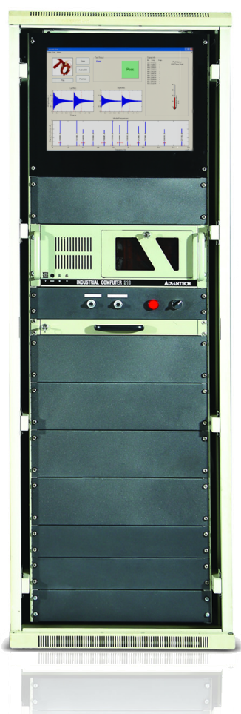
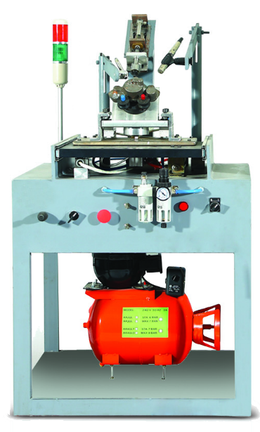
EddySonic System
We
hear Quality
Acoustic Resonant Non-Destructive Testing
  Accurate and Repeatable
  High Speed Test (1 sec), Easy to Use
  Best for Mass Production and 100% Quality Control
  Compensation of Production Trends, Temperature, and Mass
  Various Tools for Data and Pattern Modeling
  Can be Integrated with Eddy Current System
  Industrial Computer, Robust against Noise and Dust
  Documentation and Statistical Reports

Slide 21
Applications
Nodularity test: Natural frequencies are highly correlated with Nodularity. Therefore, parts with low nodularity can be easily separated.
Comparison between natural frequencies of “Good” and “Low Nodularity” parts

Slide 22
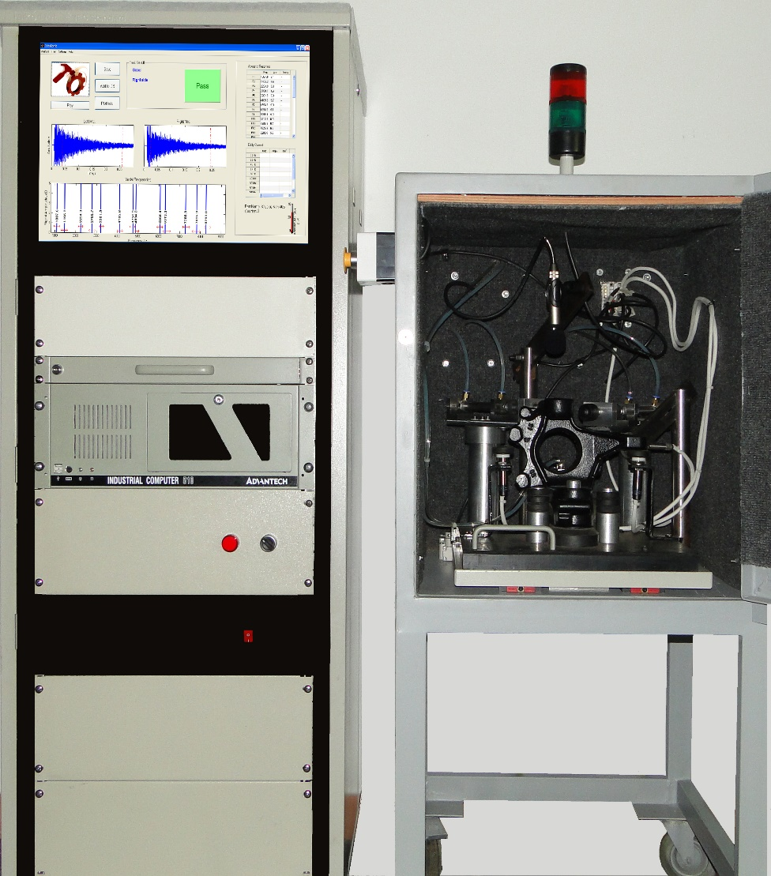
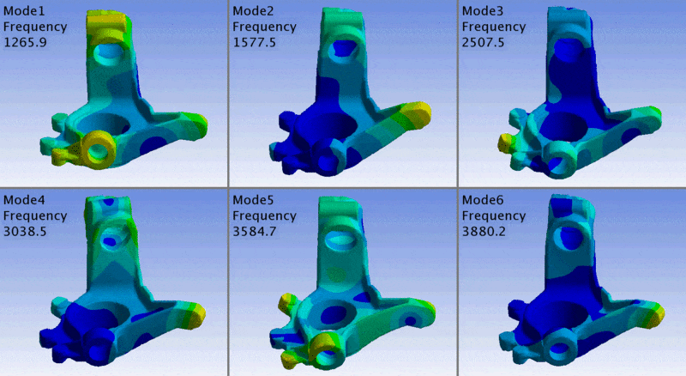
Applications
Peugeot Knuckle Arm: Nodularity test, Crack detection, Cold shut, Dimensional variations
Peugeot Knuckle Arm

Slide 23
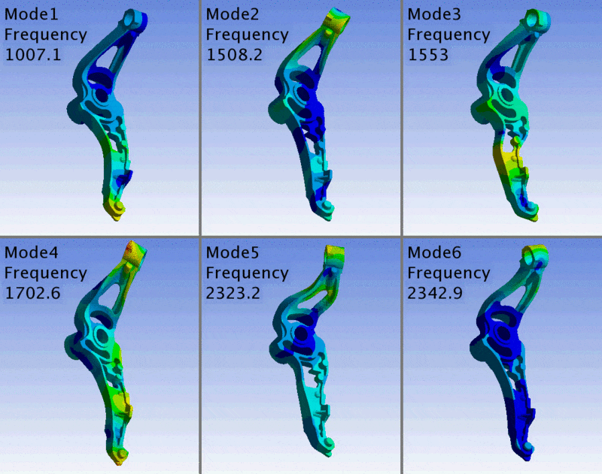
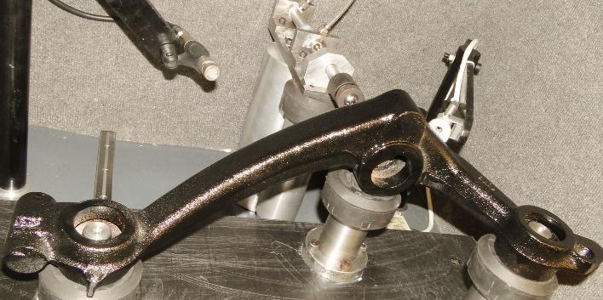
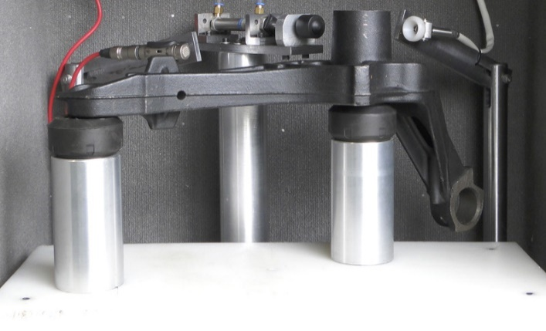
Applications
Peugeot Axle Crossmember Arm: Nodularity test, Cold shut, Dimensional variations
Peugeot Axle Crossmember Arm
Peugeot Axle Crossmember Arm

Slide 24
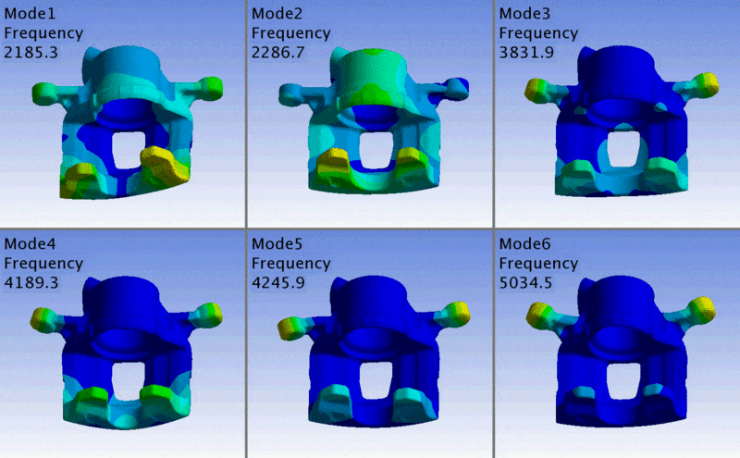
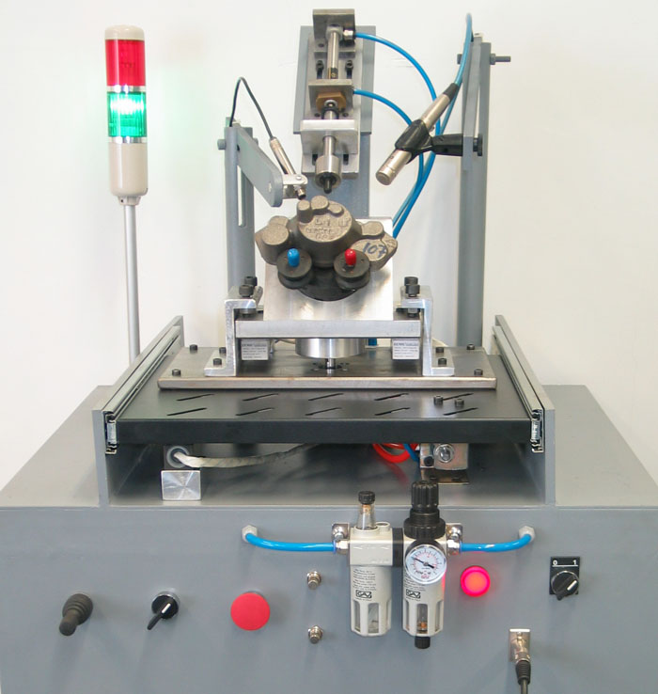
Applications
Brake Caliper: Nodularity test, Crack detection, Cold shut, Dimensional variations
Kia Pride Brake Caliper

Slide 25
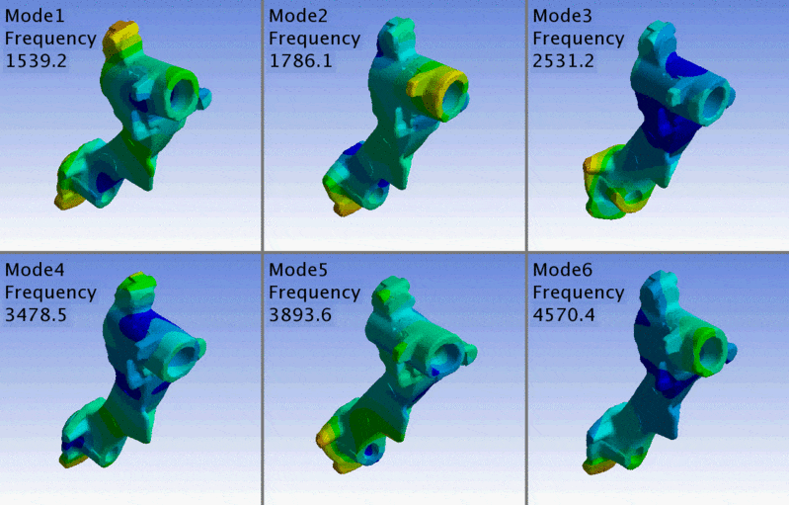
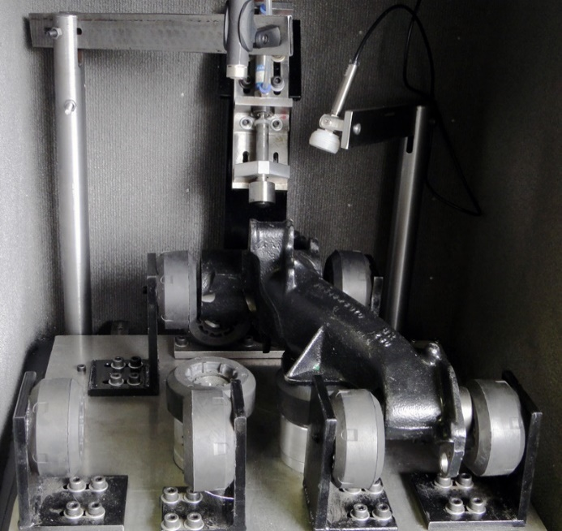
Applications
Peugeot Axle Suspension Arm: Nodularity test, Crack detection, Cold shut, Dimensional variations
Peugeot Axle Suspension Arm

Slide 26
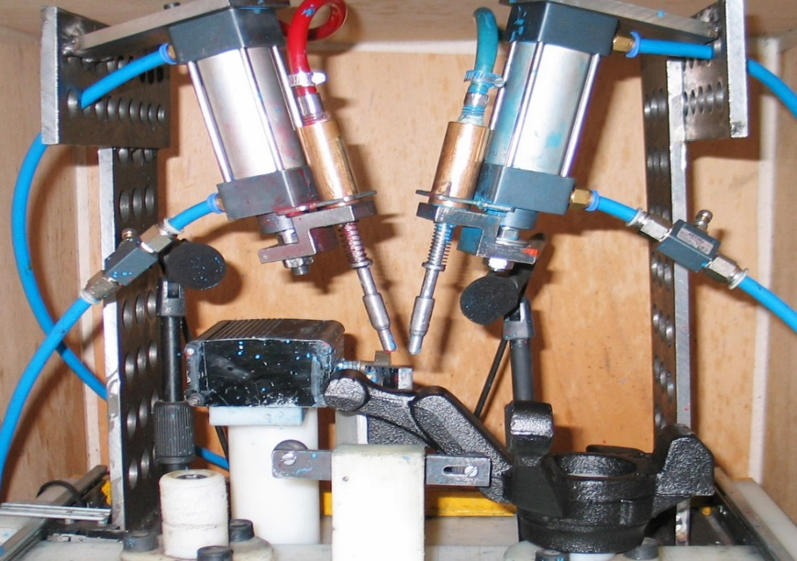
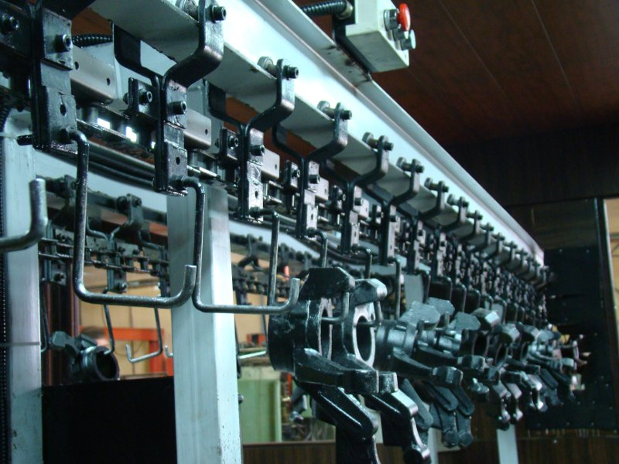
Applications
Kia Pride Knuckle Arm: Nodularity test, Residual stress, Hardness variations, Cold shut, Dimensional variations
As-Cast part before annealing
Frequencies of Good part
Bad part with hardness deviation
Kia Pride Knuckle Arm Test Line

Slide 27
Applications
Crack Detection: A crack causes Frequency Split in some modes. In some cases, the Frequency decreases and Damping increases.
Mode F3 of a “Good” drive shaft
F3 Split in a cracked drive shaft

Slide 28
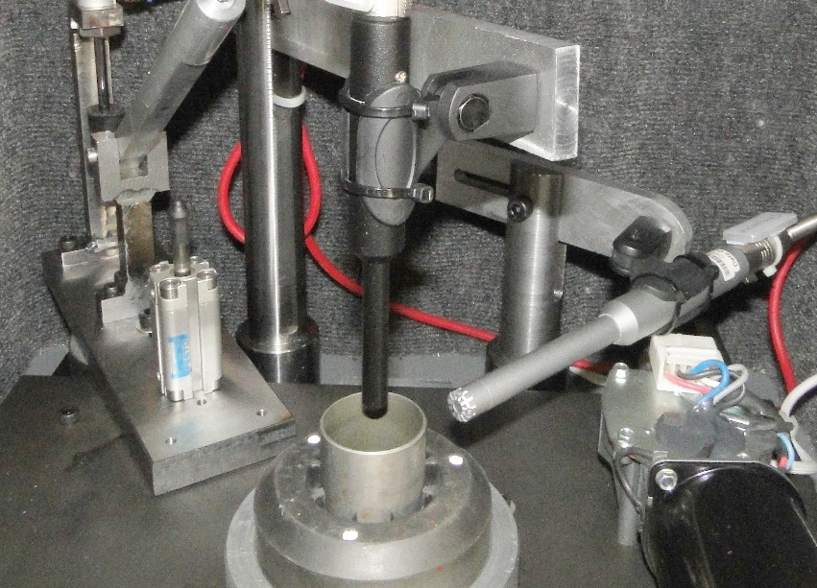
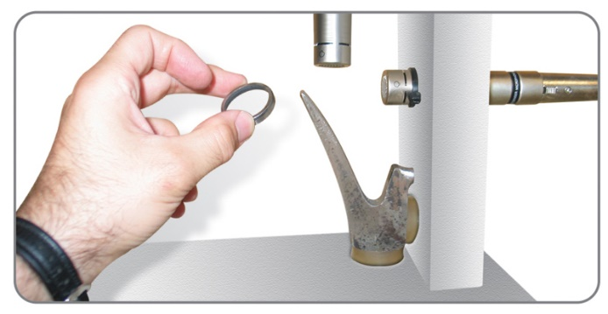
Applications
Crack Detection
Peugeot Air / Exhaust Seat
Peugeot Tappet Valve
Peugeot Axle Shaft

Slide 29
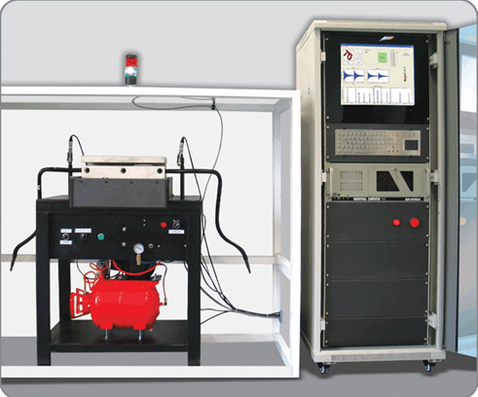
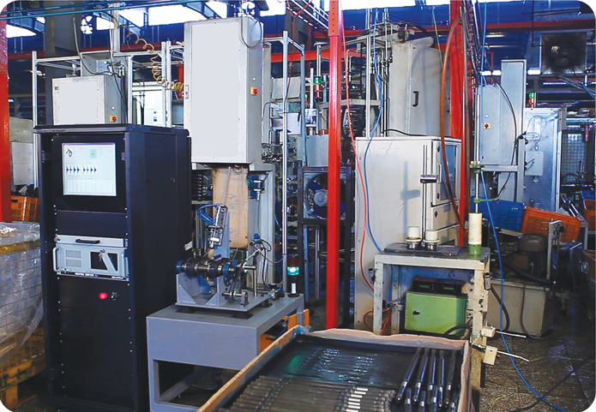
Applications
Hardness Testing
Crack Detection
Kia Pride Stabilizer Bar
Renault L90 Drive Line

Slide 30
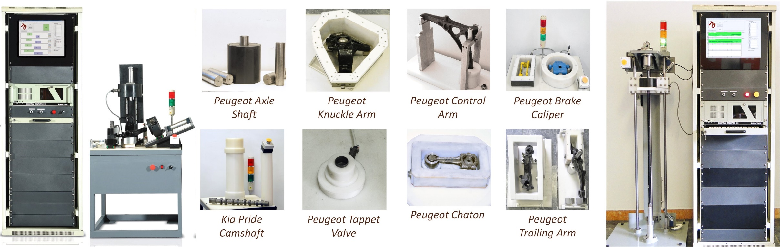
Integration with Eddy Current
Acoustic Resonant and Eddy Current are complementary tests. For safety parts, both tests should be performed.
Examples of Eddy Current system with custom coils and fixtures

Slide 31
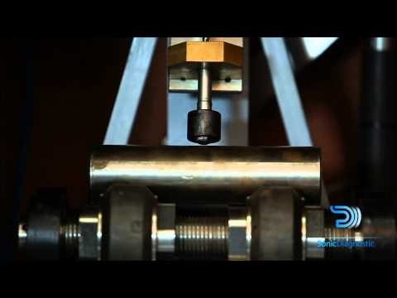
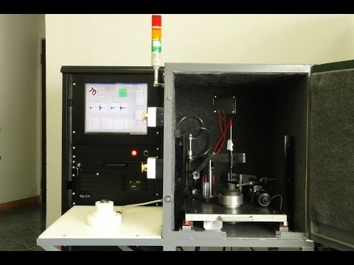
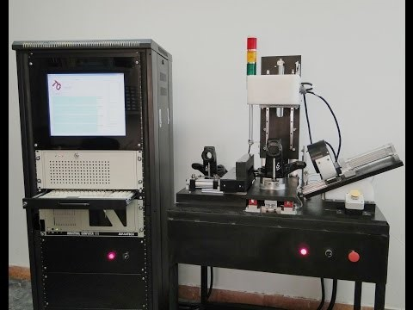
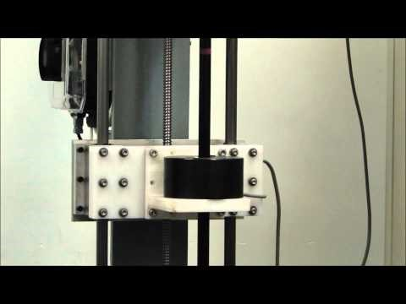
Watch More Applications from our YouTube Channel

Slide 32
Offering Total Solution to Customer
Pilot Analysis of Parts
Feasibility study and analysis of 100 Good and 50 Bad parts
Design fixture and Mechanical Unit
Install in Production Line
Training Courses
After Sales Services
Setup NDT line and integrate with production line
Training courses for NDT engineer and operator: EddySonic™ software, test procedure, calibration, maintenance, and services
Upgrade, repair, setup for other parts
Custom design the fixture, mechanical unit, automation
Train the system with a wide range of Good parts, model the trends
Technical consultation
Find the best models and tools to separate defective parts
Optimize excitation force and location, and sensor positions

Slide 33

Thank You!

